Slide 1
uLoBal: Enabling In-Network Load Balancing for Arbitrary Internet Services on SDN
Author: Alex F R Trajano
Publisher/Conference: ICN 2016 Networks
Presenter: Cheng-Feng Ke
Date: 2016/09/28
Department of Computer Science and Information Engineering
National Cheng Kung University, Taiwan R.O.C.
Notes:
1

Slide 2


Introduction
This paper presents uLoBal, a SDN-based load balancer that is capable of performing flexible and generic load balancing of arbitrary services through the use of different forwarding approaches that address most types of service.
Web request
Web server 1
Content request
CDN server 1
Web server 2
uLoBal
CDN server 2
Notes:
提出一種 uLoBal 的架構
基於 sdn 的 load balancer
可以把 request 分散道不同 server 上
而且可以定義多種服務來分散流量

Slide 3



Introduction
uLoBal has been implemented and tested on the Mininet virtualized environment that emulates a real-world network.
The testing scenario was based on a Content Delivery Network (CDN), which is one of the most common types of service that is present on the current Internet.
Notes:
環境架設在 Mininet 上模擬
CDN server 負責分散靜態內容的流量
作者特別使用這個服務應該只是為了證明他架構的可用性

Slide 4
Related Work
SDN
Software-Defined Network (SDN) is an approach to network control and management that allows administrators to manage network services.
This is done by decoupling the control plane, that takes decisions about forwarding traffic through the network infrastructure;
Notes:
將控制平面從 device 中分離出來。
將網路做集中式的控制。

Slide 5

Related Work
OpenFlow
  Controller
  Protocol
  OpenFlow-enabled device
Controller
Protocol
OpenFlow-enabled
device
OpenFlow-enabled
device
OpenFlow-enabled
device

Slide 6
Related Work
Each device maintains a Flow Table that indicates the processing applied to any packet of a certain flow.
OpenFlow-enabled
device

Slide 7

Related Work
If there is no matching entry for an incoming packet, the device sends a PacketIn message to the controller, wrapping the unmatched packet.
Controller
3. PacketIn message
(OpenFlow protocol)
1. incoming
2. no matching entry
packet
OpenFlow-enabled
device
Flow table

Slide 8
Related Work
uLoBal architecture
  Management Module
  Network Monitoring Module
  Load Balancer Module

Slide 9
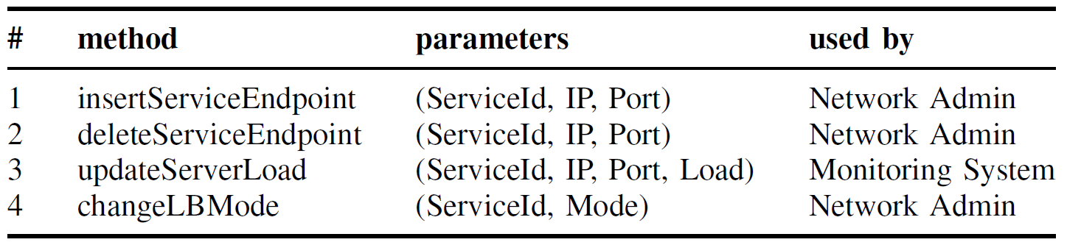
Related Work
Management Module
  Management API can be accessed through a REST (Representational State Transfer) service.
  As the SDN controller cannot perform complex load monitoring at the servers, it is necessary to expose such service in order to allow an external monitoring tool to provide such information to the load balancer.

Slide 10
Related Work
Management Module
  Methods 1 and 2 of the API use exactly this tuple in order to add or remove endpoints to/from the load balancing.
  inserServiceEndpoint(1, 127.0.0.1, 22)
  inserServiceEndpoint(1, 127.0.0.2, 22)
  inserServiceEndpoint(2, 127.0.0.3, 22)
  inserServiceEndpoint(2, 127.0.0.4, 22)
Server | ServiceId
Web server 1 127.0.0.1:22 | 1
Web server 2 127.0.0.2:22 | 1
CDN server 1 127.0.0.3:22 | 2
CDN server 2 127.0.0.4:22 | 2

Slide 11
Related Work
Management Module
  Method 3 is used by an external monitoring system that updates the load information of each server that provides access to the service, being the Load value the last load measure of a server normalized within the interval [0; 10]

Slide 12
Related Work
Management Module
  Method 4 using one of three possible values: ServerRoundRobin, ServerIpHash or NetServerLoad, making the load balancer to change the balancing algorithm.
Server | ServiceId
Web server 1 | 1
Web server 2 | 1
CDN server 1 | 2
CDN server 2 | 2
ServiceId | Mode
1 | NetServerLoad
2 | NetServerLoad

Slide 13
Related Work
Network Monitoring Module
  (1) collect statistics on every port of every switch of the SDN at predefined time intervals;
  (2) calculate the minimum spanning tree of the network graph using the collected statistics as the cost metric.
  Dijkstra algorithm is used to compute the minimum spanning tree.
Notes:
1. 定期向每個 switch 收集資料。

Slide 14
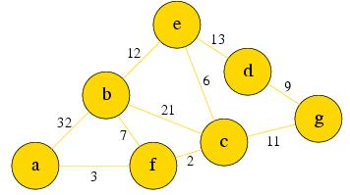
Related Work
Network Monitoring Module
  Dijkstra algorithm
  LinkCost = b + e
  b is the percentage of the used link’s bandwidth.
  e is the percentage of packets that have suffered of either drops or transmission errors.
  The LinkCost must be normalized within the interval [0; 10].

Slide 15
Related Work
Load Balancer Module
  Algorithm 1: PacketIn handling algorithm
  Three operational modes:
    Algorithm 2: Round Robin algorithm(RR) (Static)
    Algorithm 3: IP Hashing algorithm(IPH) (Static)
    Algorithm 4: Network and Server Load algorithm(NSL) (Dynamic)

Slide 16
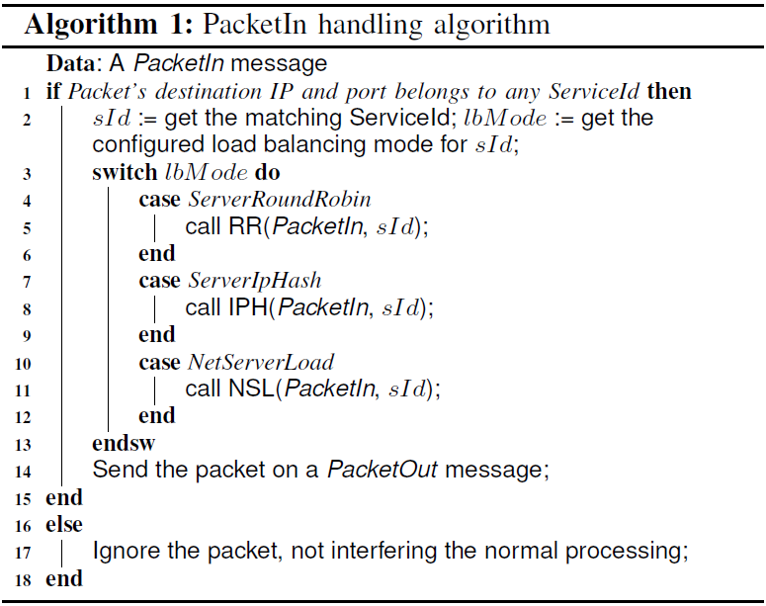
Related Work
Load Balancer Module

Slide 17
Related Work
Load Balancer Module
  Algorithm 1: PacketIn handling algorithm
Get Service Id
ServiceId = 1
Get Mode
Mode = NetServerLoad
RR
Dst = 127.0.0.1:22
Ignore the packet
IPH
ServiceId = NULL
Server | ServiceId
Web server 1 127.0.0.1:22 | 1
Web server 2 127.0.0.2:22 | 1
CDN server 1 127.0.0.3:22 | 2
CDN server 2 127.0.0.4:22 | 2
NSL
ServiceId | Mode
1 | NetServerLoad
2 | NetServerLoad

Slide 18
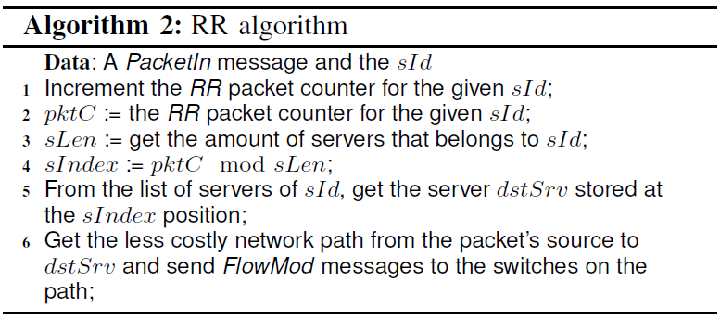
Related Work
Load Balancer Module

Slide 19
Related Work
Load Balancer Module
ServiceId | RR packet count
1 | 1
2 | 12
pktC = 1
Increment counter
pktC % sLen
1
Position | Server | ServiceId
0 | Web server 1 | 1
1 | Web server 2 | 1
ServiceId = 1
ServiceId | RR packet count
1 | 0
2 | 12
sLen = 2

Slide 20
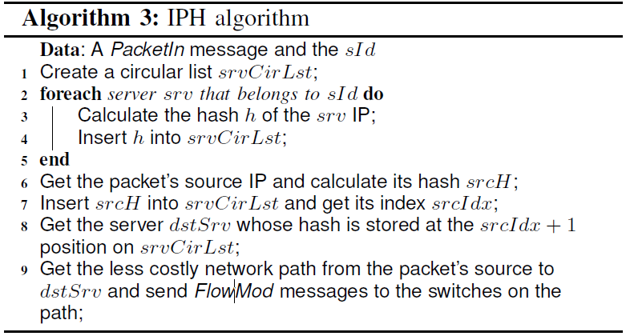
Related Work
Load Balancer Module

Slide 21
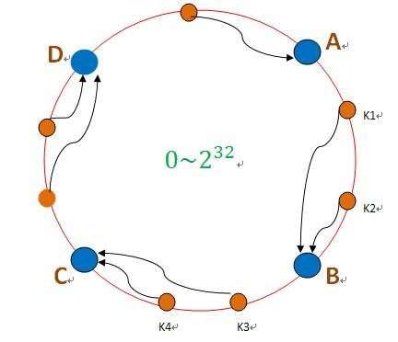
Related Work
Load Balancer Module
  Consistent hashing
  The main goal is to always forward requests made by a user to the same endpoint.
  Context information can be locally cached.

Slide 22
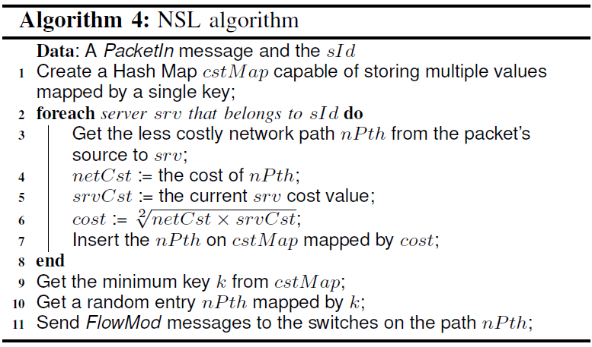
Related Work
Load Balancer Module

Slide 23
Related Work
Load Balancer Module
Less costly network path nPth from the packet’s
source to
ServiceId = 1
Server | netCst (Cost of nPath) | srvCst (Cost of Server) | cost (geometric mean)
Web server 1 | 2 | 8 | (2 * 8) ^ 0.5 = 4
Web server 2 | 3 | 3 | (3 * 3) ^ 0.5 = 3
Insert the nPath on HashMap
mapped by cost.
Cost (key) | Server | nPath
3 | Web server 1 | nPath1
4 | Web server 2 | nPath2
Get the minimum key

Slide 24
EVALUATION
The possibility to set link bandwidth and delay in Mininet allowed us to perform an experiment similar to an actual real scenario.
Abilene network topology
The topology’s sources were obtained from the TopologyZoo.

Slide 25
EVALUATION
The first scenario aims to evaluate only the network load balancing by avoiding the server load balancing, allowing better analysis of the proposal behavior. To this extent, the network topology has only a single server that is accessed by several clients spread over the network.
CDN Server

Slide 26
EVALUATION
The second scenario aims to compare how the different load balancing modes affect (1) the client perceived latency and (2) the server load. Again, the clients are going to request contents on CDN servers that operate through HTTP. In this scenario, we used three CDN servers.
CDN Server
CDN Server
CDN Server

Slide 27
EVALUATION
A set of 10 clients has been placed in order to make content requests. Each client was configured to perform sequential requests to a randomly chosen server.
After each client finished 10^6 requests, the experiments results were collected and the graphs in Figures 4, 5 and 6 were built.
Notes:
有 10 個 client 分布在每個節點上
每個 request 隨機選擇 server
每個 client 發出 10^6 個 request

Slide 28
EVALUATION
Figure 4. Result of the first experiment.

Slide 29
EVALUATION
Figure 5. Results of the second experiment, from the point of view of the clients perceived delay.

Slide 30
EVALUATION
Both RR and IPH have similar behaviors at different workloads, although the RR shows better latency results.
Such results can be explained by the fact that the network nodes are spread over an area of a whole country, with the servers being positioned at the edges of the network, which makes the use of these techniques a bad idea due to the high distance, increasing the end-to-end delay.
Notes:
RR 和 IPH 的走向都差不多
RR 有比較低的延遲
似乎是因為距離的關係

Slide 31
EVALUATION
Figure 6. Results of the second experiment, from the point of view of the servers average load.

Slide 32
EVALUATION
Again, both RR and IPH modes are similar to different workloads, unless the responses’ sizes were 1600 KB.
This result was expected, since these load balancing schemas aim to distribute the requests evenly across the servers, not looking for any external factor on the decisionmaking process.
Furthermore, it was not observed any significant change in the consumption of resources in the network controller, even when using the NSL mode, suggesting that uLoBal follows the same scalability levels of the network controller.
Notes:
RR 在 Response size 1600 KB 時，表現比 IPH 好
因為 RR 是平均分佈，IPH 有機會較不平均。
看起來每個封包都會被導入 controller ，但作者說這對 controller 沒有什麼負擔，不過沒有提出什麼數據。

